Slide 1



Ruby on Rails 101

Slide 2
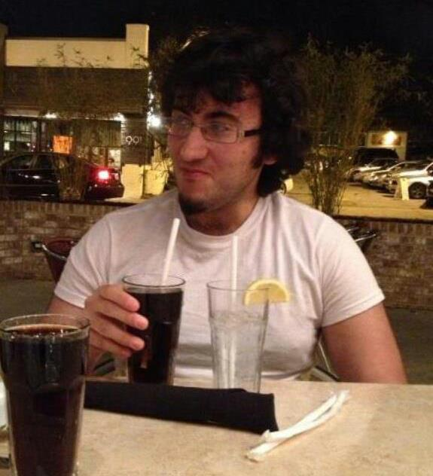
Who are you?
Marwan Nakhaleh
Third year computer science and engineering student at Ohio State
One and a half years' experience with Ruby on Rails
http://marwannakhaleh.com

Slide 3
Who am I?
Introduce yourself!

Slide 4
Polling!
Who knows what a web framework is?
Who knows what Ruby on Rails is?

Slide 5
What is Ruby on Rails?
Ruby on Rails, commonly referred to as Rails, is an open source web application framework written in the Ruby programming language.
It's a full-stack framework, meaning that Rails by itself can hold a complete application.
Rails emphasizes the model-view-controller software paradigm.

Slide 6
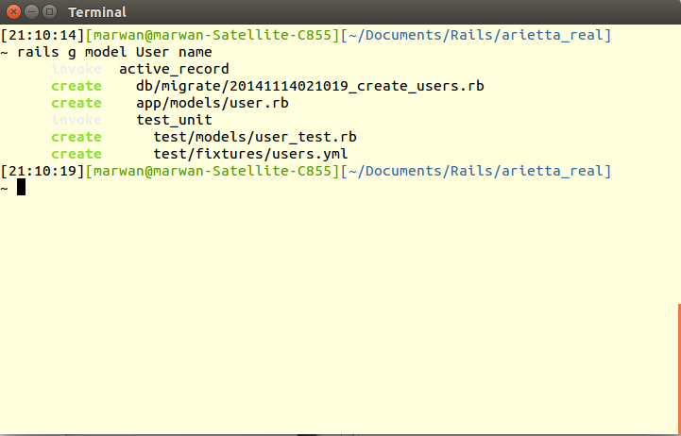
Convention vs. Configuration

Slide 7
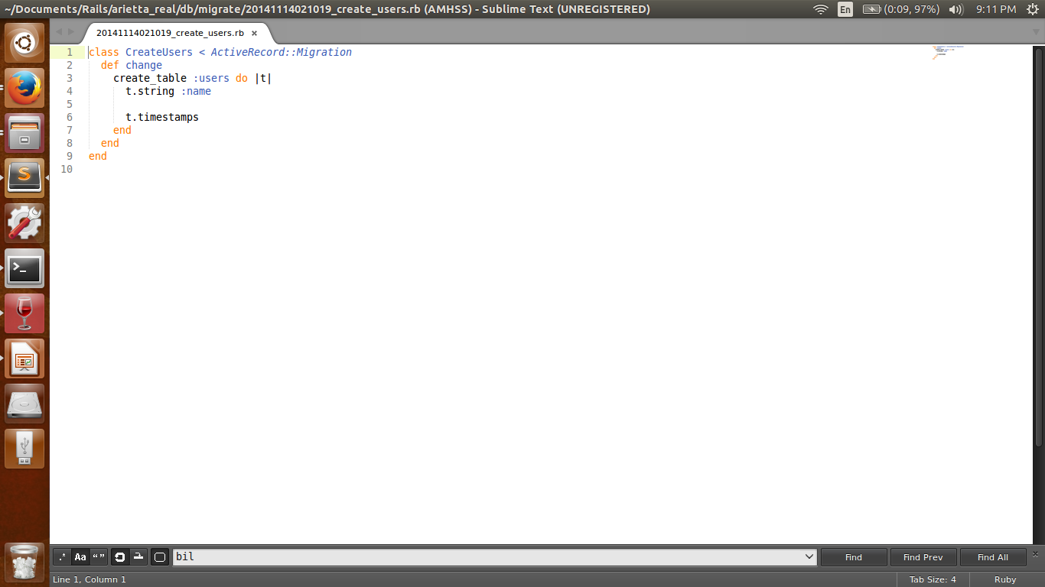
Convention vs. Configuration

Slide 8
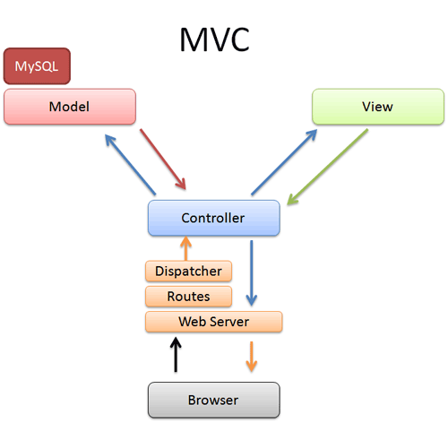
Model-View-Controller: An Overview

Slide 9
HTTP Commands
GET
Retrieves a representation of a resource
POST
Puts new resources with a generated ID
DELETE
Removes resources

Slide 10
RubyGems
Package manager for Ruby
That's how we're gonna install Rails!
Allows for certain plugins to be used with Rails applications
Devise (authentication), PostgreSQL (database), Paperclip (image upload), will_paginate (pagination)

Slide 11
Who's running what?
Windows?
Linux?
Mac?

Slide 12
Let’s make something!
Super basic Twitter clone
Full authentication with Devise!
Tweet model!

Slide 13
Additional Resources
Setup Rails on Windows
http://rubyonrails.org/download/
Setup Rails on Mac
https://gorails.com/setup/osx/10.10-yosemite
Setup Rails on Ubuntu Linux
https://gorails.com/setup/ubuntu/14.10
Don't worry about configuring Git unless you want to!
Build a full-fledged Twitter clone from scratch with Ruby on Rails
http://railstutorial.net/book
Rails for Zombies
http://railsforzombies.org
Demo app on Github
https://github.com/MarwanNakhaleh/RailsWorkshop.git

